Slide 1
Update on Micro-transit Models
Siwei Hu
07/21/2023

Slide 2
Current on-going work
Preparation of Integration (Thursday morning, work on it)
Supply side
Transit network shortest path (stochastic waiting time for every passenger) – working, especially stochastic waiting time
Auto network shortest path (fixed travel time) - finished
Demand side
Convert ActivitySim MGRA level Demand to the nodal-level demand in our multi-modal system – working
Integration (Thursday afternoon and evrning, work on it)
Choice Models - finished;
FleetPy (simulation) – need to convert its output into choice model;
Fixed Route Transit (Supply side – item 1 – working on it);
AutoNetwork (lookup table - finished);

Slide 3
Current on-going work
Preparation of Integration (Thursday morning, work on it)
Supply side
Transit network shortest path (stochastic waiting time for every passenger) – to be finished on Friday afternoon
Auto network shortest path (fixed travel time) - finished
Demand side
Convert ActivitySim MGRA level Demand to the nodal-level demand in our multi-modal system – Finished
Integration (Thursday afternoon and evrning, work on it)
Choice Models - finished;
FleetPy (simulation) – need to convert its output into choice model;
Fixed Route Transit (Supply side – item 1 – working on it);
AutoNetwork (lookup table - finished);

Slide 4
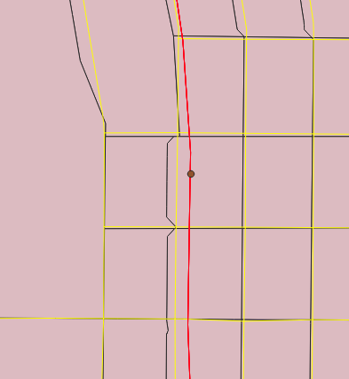
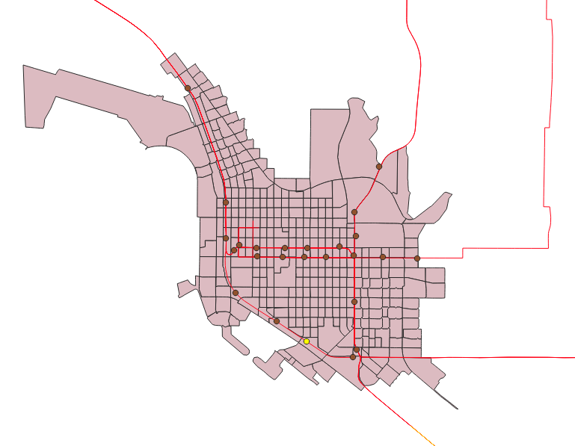
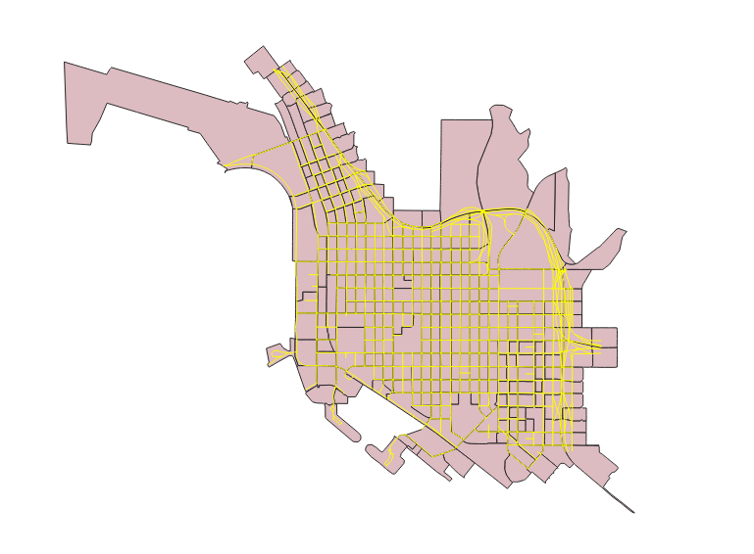
Fixed route transit system modeling
Walking network
(auto network using walking speed – 3.57mile/hour)
Skims considered fixed
Network Node-Transit Stop Connector
(transit waiting time will be incorporated in this “connector”, which is stochastic)
Transit network
(Transit network using 21 mile/hour speed)
Skims considered fixed

Slide 5
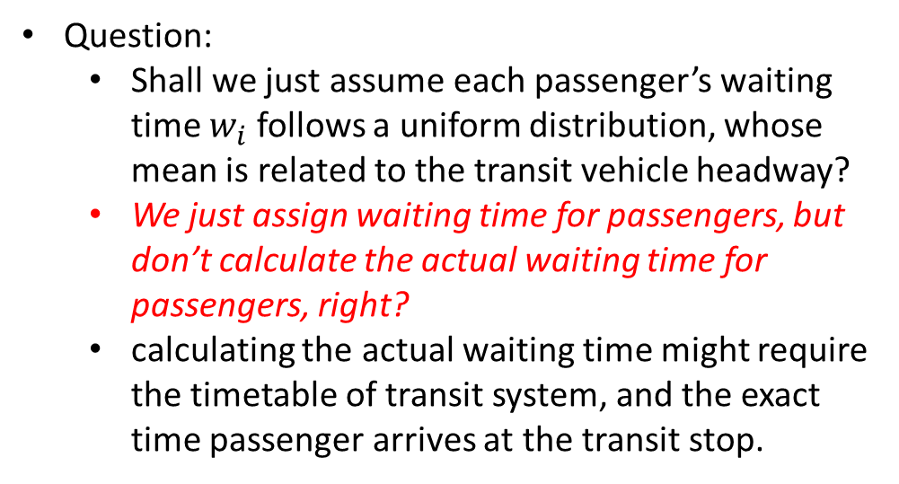
Question: Fixed route transit system modeling
Question:
Shall we just assume each passenger’s waiting time $w_{i}$ follows a uniform distribution, whose mean is related to the transit vehicle headway?
We just assign waiting time for passengers, but don’t calculate the actual waiting time for passengers, right?
calculating the actual waiting time might require the timetable of transit system, and the exact time passenger arrives at the transit stop.
Network Node-Transit Stop
(transit waiting time will be incorporated in this “connector”)

Slide 6
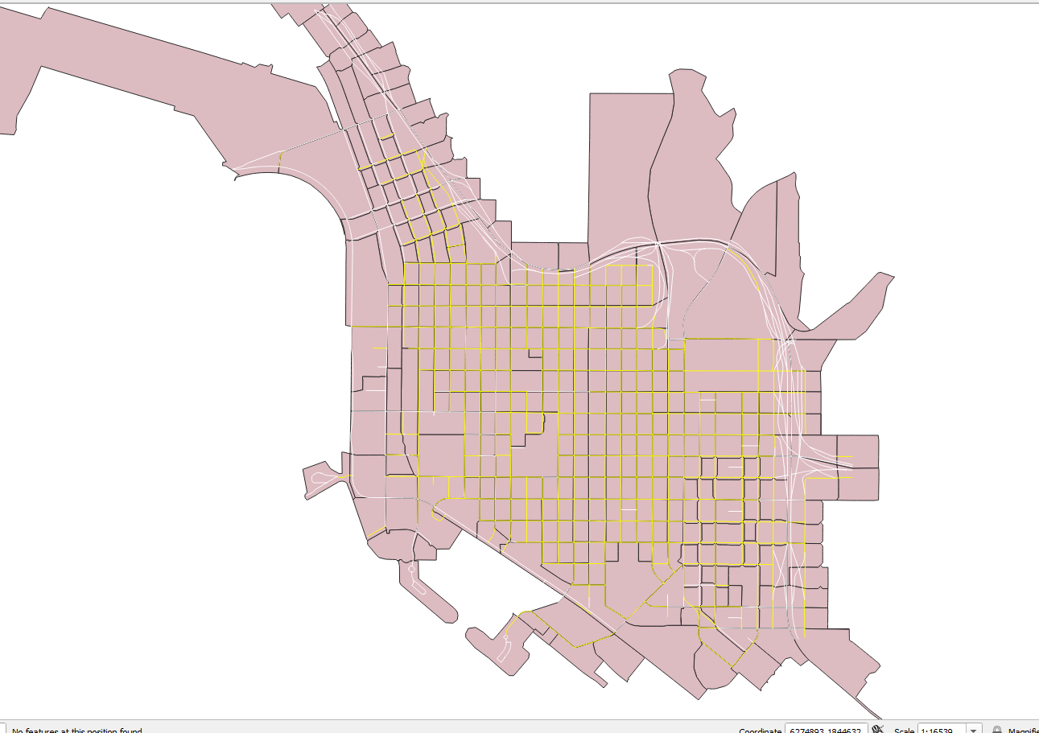
Demand Nodes
Auto, fixed route transit, and microtransit demand will be loaded in these nodes, whose link speed is 20 mph.
Yellow links with speed = 20 mph

Slide 7
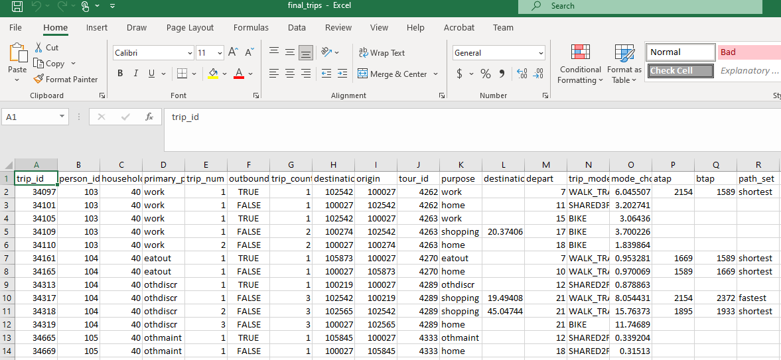
Demand Modeling
ActivitySim’s trip output is in MGRA level
However, our network table doesn’t say which node is in which MGRA.
Trip demand from ActivitySim (OD are in MGRA level)
This slide explain how we connect ActivitySim output to our request input

Slide 8
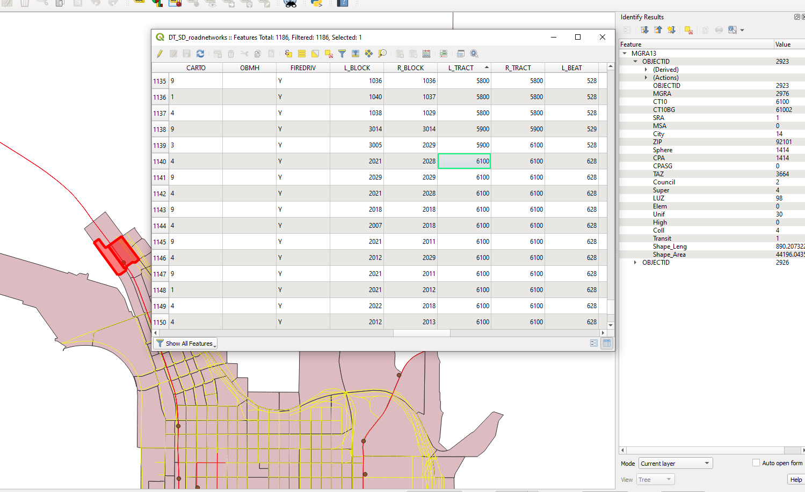
Demand Modeling
ActivitySim’s trip output is in MGRA level
However, our network table doesn’t say which node is in which MGRA.
But our network table says which nodes are in which census tract. And MGRA Table also says which MGRA is in which census tract.
So we plan to aggregate the OD demand in MGRA level to census tract level, and then distribute demand randomly among all the nodes in the census tract.
This slide explain how we connect ActivitySim output to our request input

Slide 9
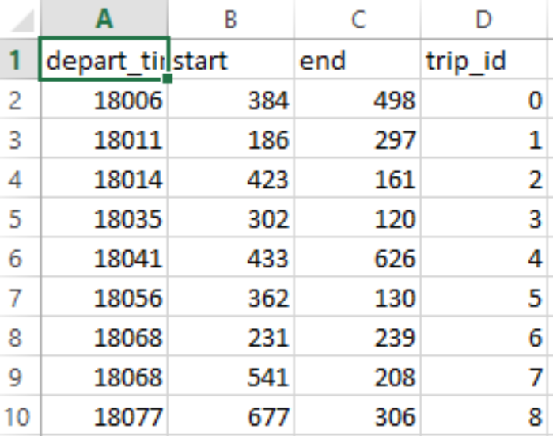
Demand Modeling - Finished
24 hour demand – first trip starts from 5am (5*3,600=18,000)

Slide 10
Demand Modeling – Mode Share
auto_trips 9213
tnc_trips 2187
transit_trips 34841
total_trips 46241
auto_trips(%) 19.9%
tnc_trips(%) 4.7%
transit_trips(%) 75.4%
24 hour demand – first trip starts from 5am (5*3,600=18,000)

Slide 11
Fixed route transit – supply side - working
#link type:
#0: walk_link;
#1: transit link;
#2: walk_transit_connector (waiting time - associate to headway);
#3: within_transit_stop_wait_time (waiting time - 30sec for passengers to board)
#4: transfer connector (transfer penalty)

Slide 12
Current on-going work
Preparation of Integration (Thursday morning, work on it)
Supply side
Transit network shortest path (stochastic waiting time for every passenger) – working, especially stochastic waiting time
Auto network shortest path (fixed travel time) - finished
Demand side
Convert ActivitySim MGRA level Demand to the nodal-level demand in our multi-modal system – working
Integration (Thursday afternoon and evrning, work on it)
Choice Models - finished;
FleetPy (simulation) – need to convert its output into choice model;
Fixed Route Transit (Supply side – item 1 – working on it);
AutoNetwork (lookup table - finished);

